Slide 1

Presentation on MongoTemplate
Prepared By : Mayank Jain

Slide 2

Content
Mongo DB Introduction
Mongo DB Vs MySql
Data Modelling (Schema)
Companies Using MongoDB
Mongo DB GUI Tools
CRUD Operation
Aggregation

Slide 3
Mongo DB Introduction
Document-oriented NoSQL database.
Used for high volume data storage.
It is an open-source, cross-platform database.
Provides, high performance, high availability, and easy scalability.
Written in C++.
Founded in 2007 by Dwight Merriman, Eliot Horowitz and Kevin Ryan – the team behind DoubleClick.
Schemaless.

Slide 4

Mongo DB VS MySql

Slide 5
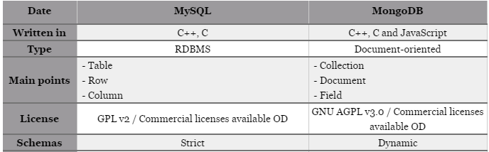
Mongo DB VS MySql

Slide 6
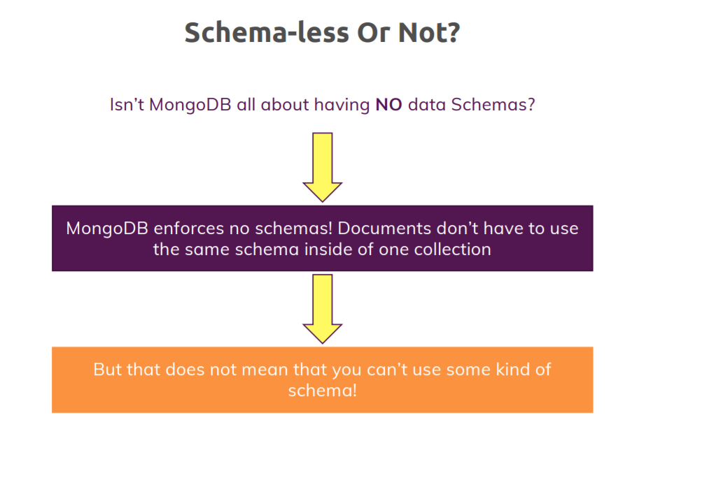
Schema

Slide 7

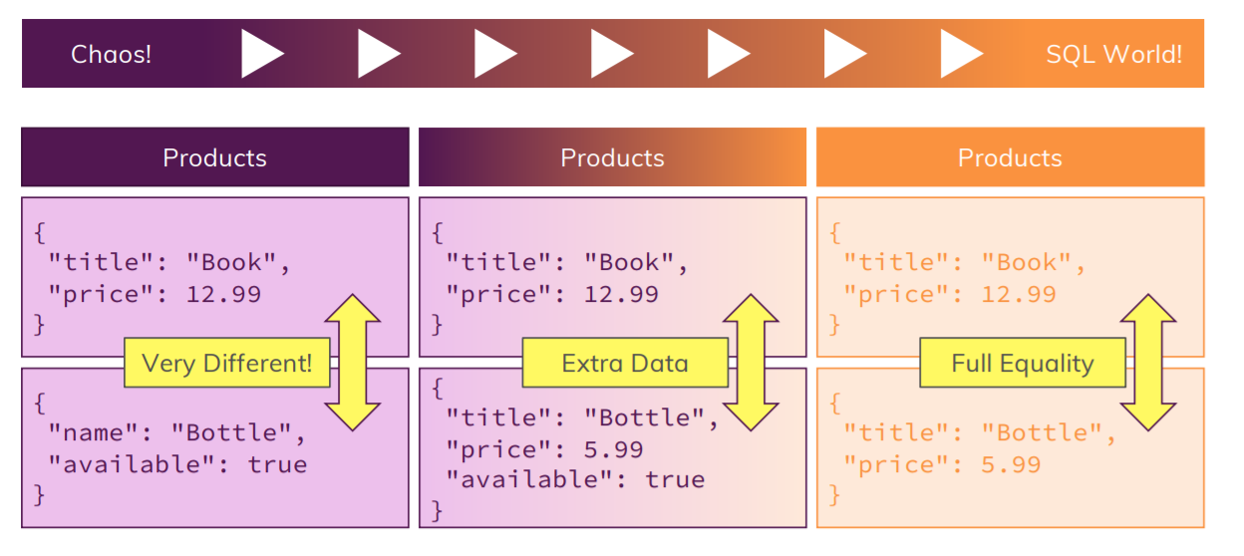
Schema

Slide 8
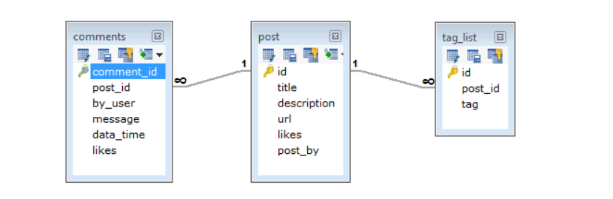
Schema
Some considerations while designing Schema in MongoDB
Design your schema according to user requirements.
Combine objects into one document if you will use them together. Otherwise separate them (but make sure there should not be need of joins).
Do joins while write, not on read.

Slide 9
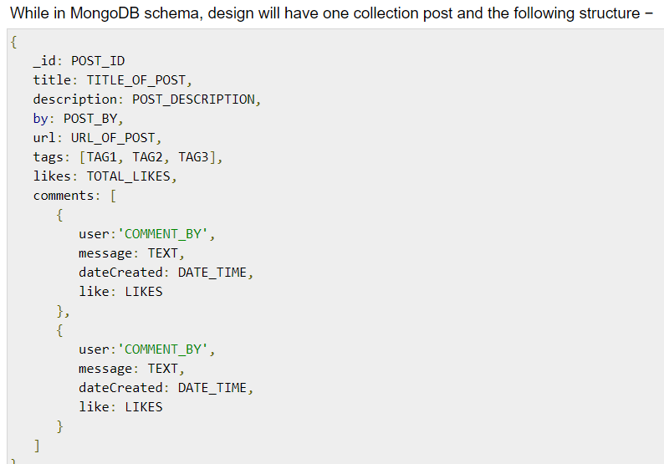
Schema

Slide 10
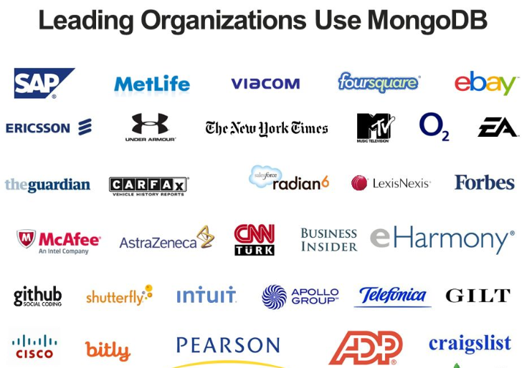
Companies Using MongoDB

Slide 11





Mongo DB GUI Tools

Slide 12
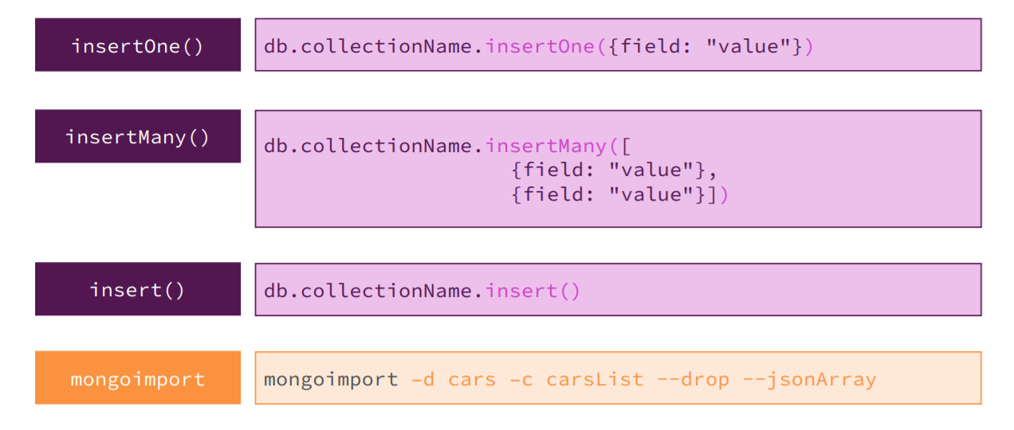
CRUD Operations
CREATE.

Slide 13
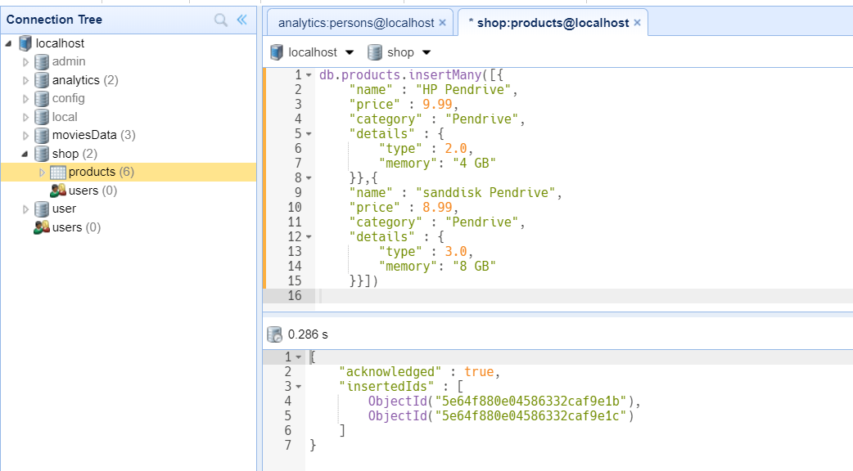
CRUD Operations
Examples of Create operation

Slide 14
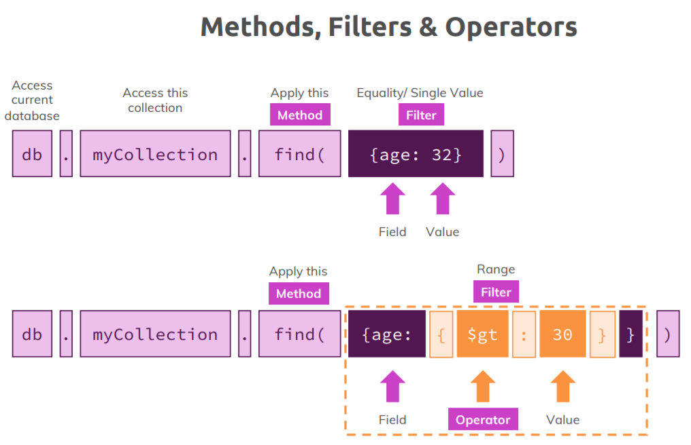
CRUD Operations
READ

Slide 15
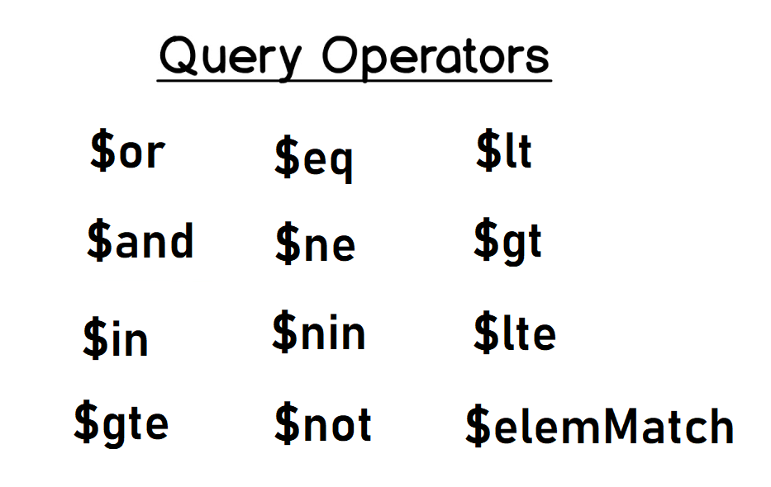
CRUD Operations
READ

Slide 16
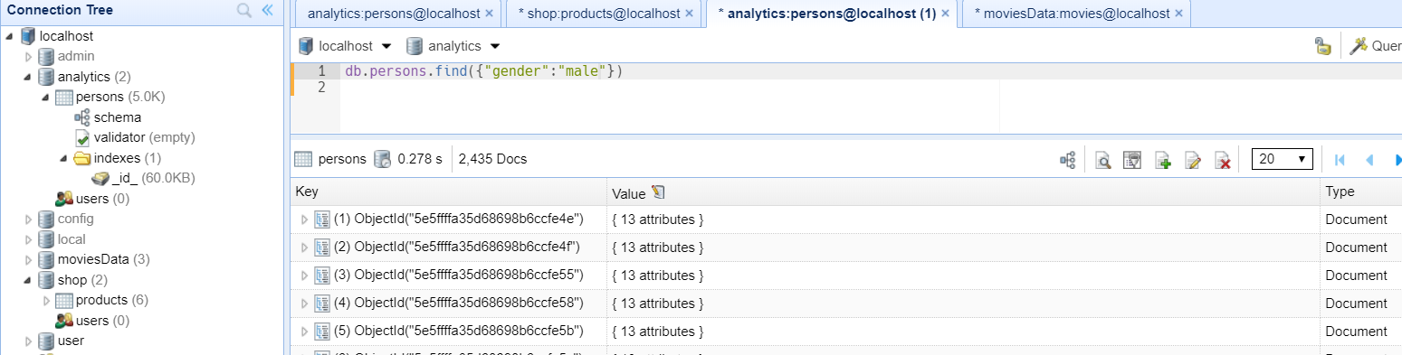
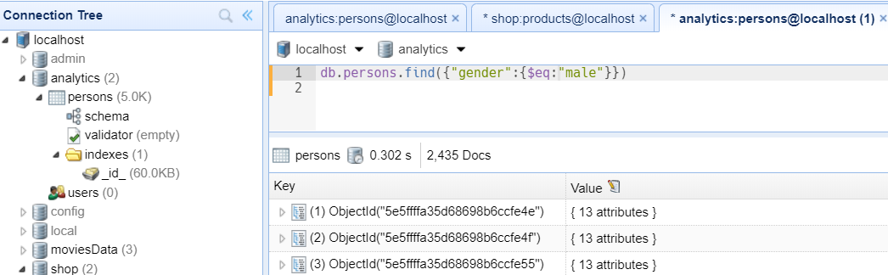
CRUD Operations
Example's
db.persons.find({"gender":{$eq:"male"}})

Slide 17
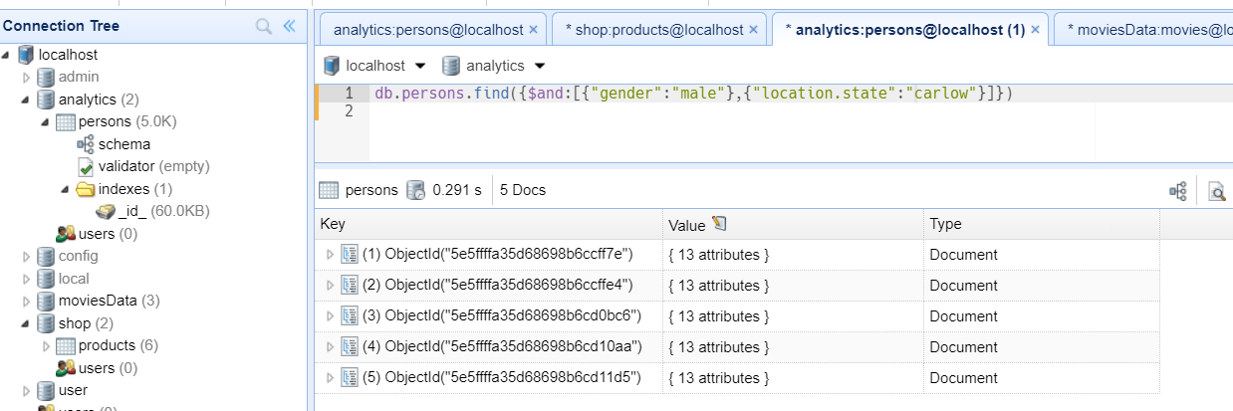
CRUD Operations
Example's
db.persons.find({$and:[{"gender":"male"},{"location.state":"carlow"}]})

Slide 18
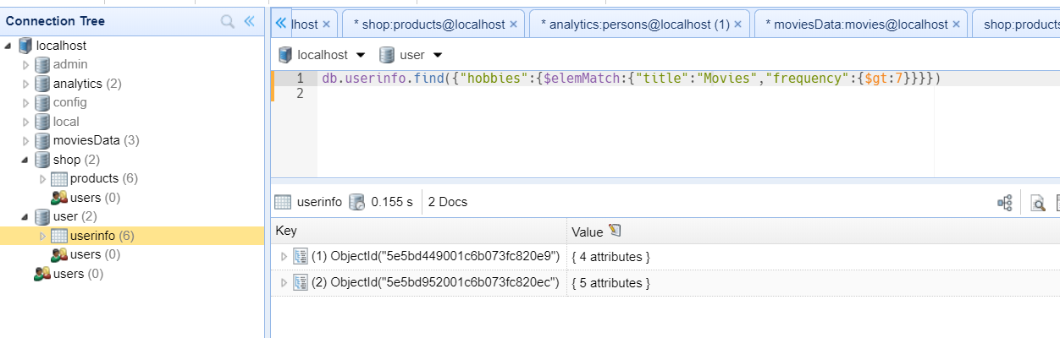
CRUD Operations
Example's
db.userinfo.find({"hobbies":{$elemMatch:{"title":"Movies","frequency":{$gt:7}}}})

Slide 19
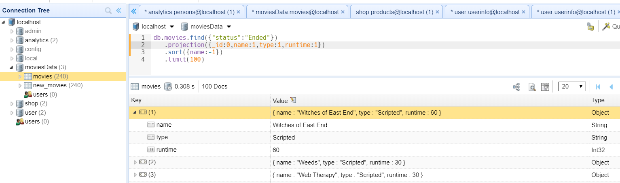
CRUD Operations
Projection, Sort, Limit
db.movies.find({"status":"Ended"})
.projection({_id:0,name:1,type:1,runtime:1})
.sort({name:-1})
.limit(100)

Slide 20

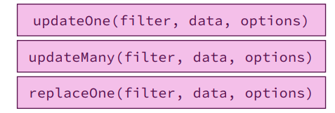
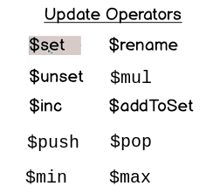
CRUD Operations
UPDATE

Slide 21
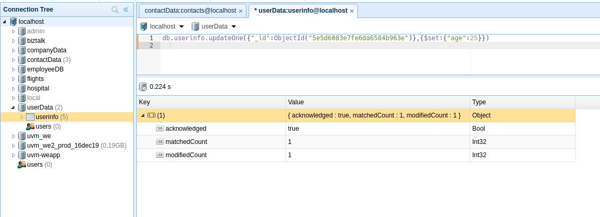
CRUD Operations
UPDATE
db.userinfo.updateOne({"_id":ObjectId("5e5d6083e7fe6da6584b963e")},{$set:{"age":25}})

Slide 22
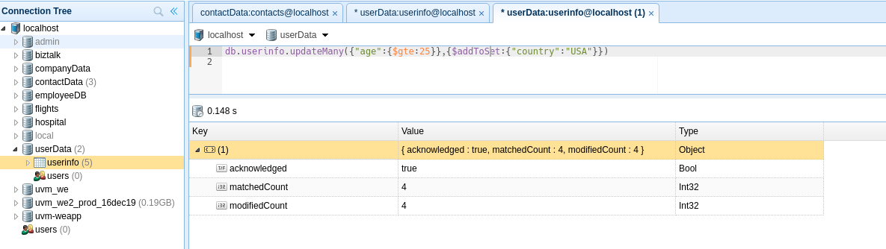
CRUD Operations
UPDATE
db.userinfo.updateMany({"age":{$gte:25}},{$addToSet:{"country":"USA"}})

Slide 23
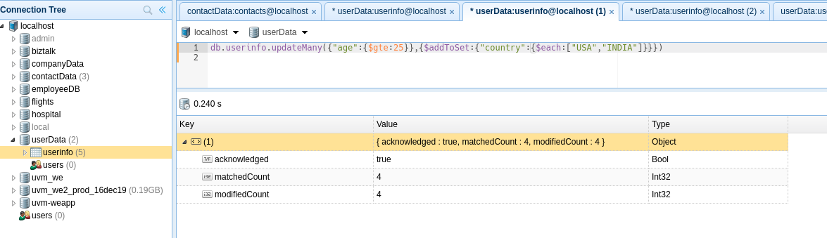
CRUD Operations
UPDATE
db.userinfo.updateMany({"age":{$gte:25}},{$addToSet:{"country":{$each:["USA","INDIA"]}}})

Slide 24
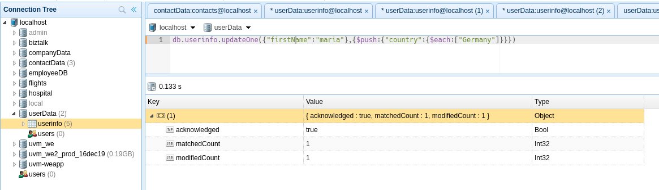
CRUD Operations
UPDATE
db.userinfo.updateOne({"firstName":"maria"},{$push:{"country":{$each:["Germany"]}}})

Slide 25
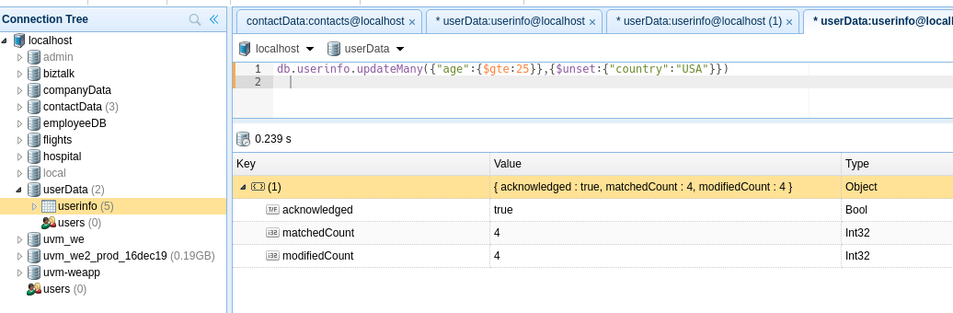
CRUD Operations
UPDATE
db.userinfo.updateMany({"age":{$gte:25}},{$unset:{"country":"USA"}})

Slide 26
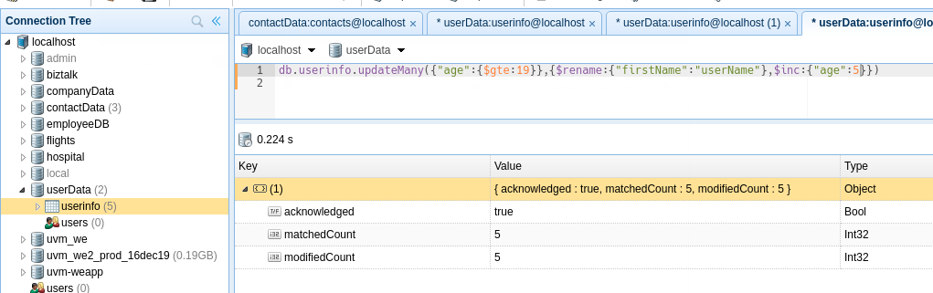
CRUD Operations
UPDATE
db.userinfo.updateMany({"age":{$gte:19}},{$rename:{"firstName":"userName"},$inc:{"age":5}})

Slide 27
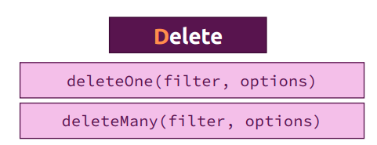
CRUD Operations
DELETE

Slide 28
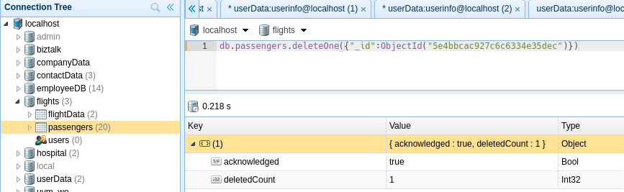
CRUD Operations
DELETE
db.passengers.deleteOne({"_id":ObjectId("5e4bbcac927c6c6334e35dec")})

Slide 29
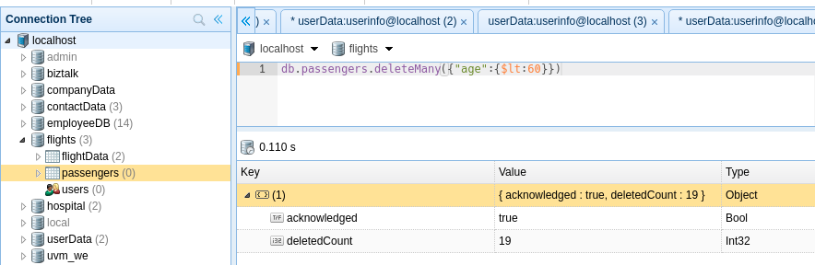
CRUD Operations
DELETE
db.passengers.deleteMany({"age":{$lt:60}})

Slide 30
AGGREGATION
If you want to show your data using graphical way then aggregation comes in a picture.
Aggregation in MongoDB is an operation used to process the data that returns the computed results.
Aggregation basically groups the data from multiple documents and operates in many ways on those grouped data in order to return one combined result.
It processes documents and return computed results and can perform a variety of operations on the grouped data to return a single result.

Slide 31
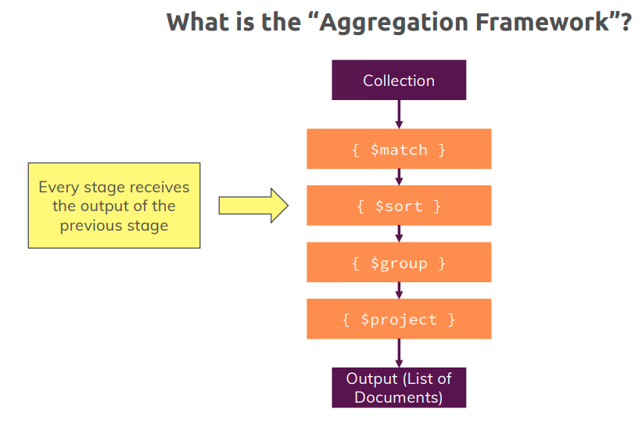
AGGREGATION

Slide 32
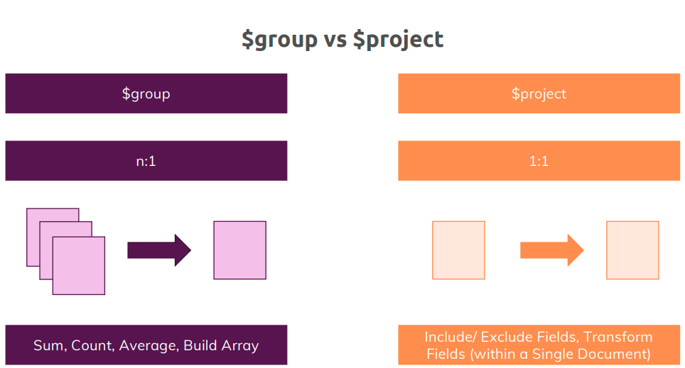
AGGREGATION

Slide 33
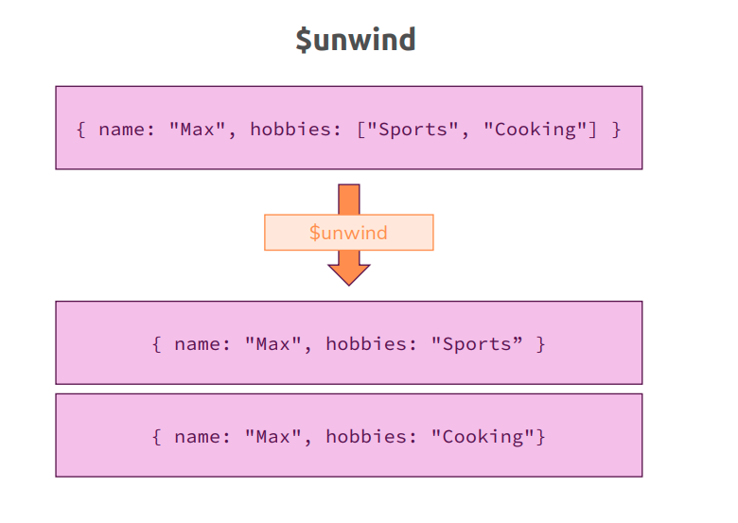
AGGREGATION

Slide 34
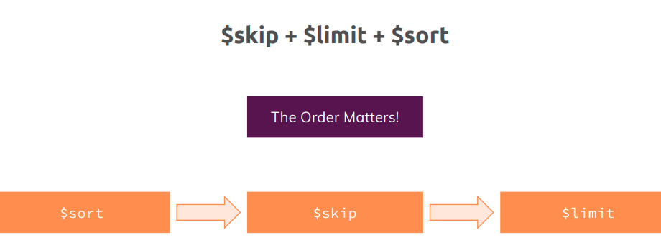
AGGREGATION

Slide 35
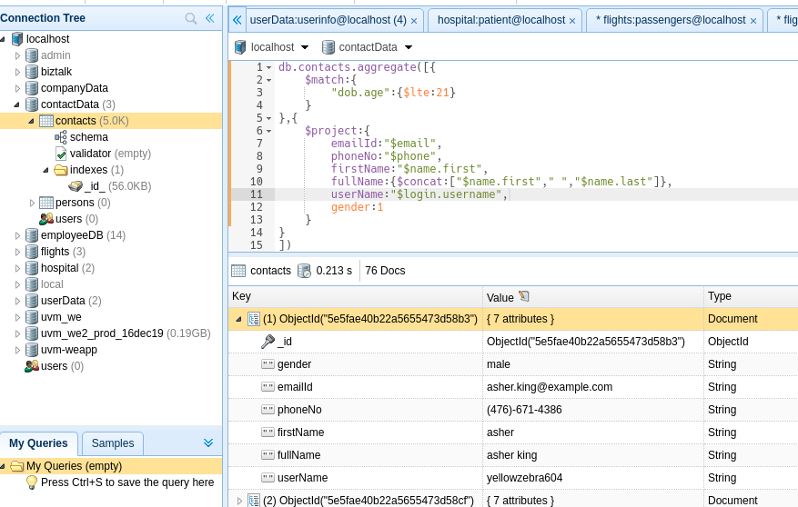
AGGREGATION
Example:1
db.contacts.aggregate([{
$match:{"dob.age":{$lte:21}}},{$project:{
emailId:"$email",phoneNo:"$phone",firstName:"$name.first",fullName:{$concat:["$name.first"," ","$name.last"]},userName:"$login.username",gender:1
}
}
])

Slide 36
AGGREGATION
Example:2
db.contacts.aggregate([{
$match:{"dob.age":{$lte:21}}
},{
$project:{
male:{$cond:{if:{$eq:["$gender","male"]},then:1,else:0}},
female:{$cond:{if:{$eq:["$gender","female"]},then:1,else:0}}
}
},
{
$group:{
_id:null,
male:{$sum:"$male"},
female:{$sum:"$female"},
total:{$sum:1}
}
}
])

Slide 37
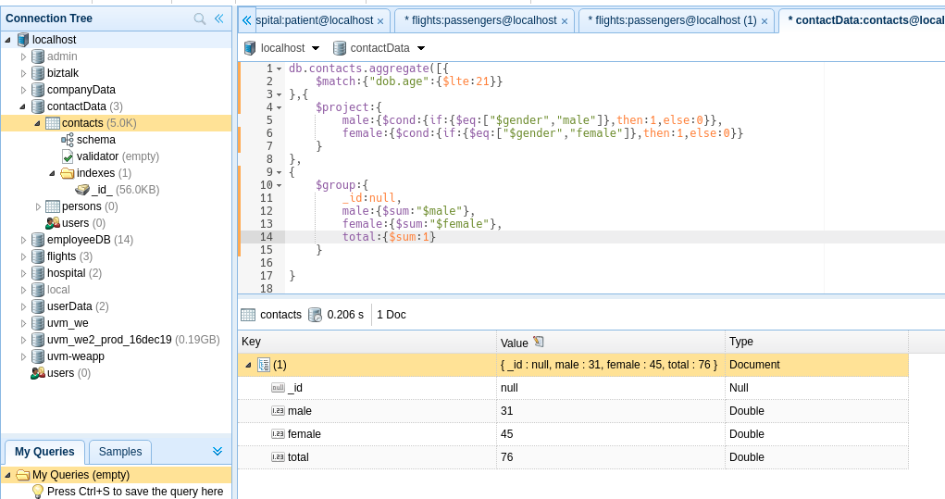
AGGREGATION
Example:2

Slide 38
Thanks....

